Slide 1
Walmart Superstore Sales Analysis
Data visualization

Slide 2
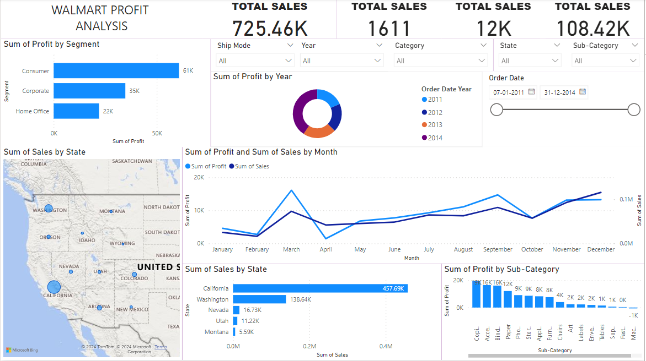
PROFIT DASHBOARD

Slide 3
HIGHLIGHTS OF PROFIT ANALYSIS
SUM OF PROFIT BY SEGMENT
SUM OF SALES BY STATE
SUM OF PROFIT BY YEAR
SUM OF PROFIT AND SUM OF SALES BY MONTH
SUM OF SALES BY STATE
SUM OF PROFIT BY SUB CATEGORY

Slide 4
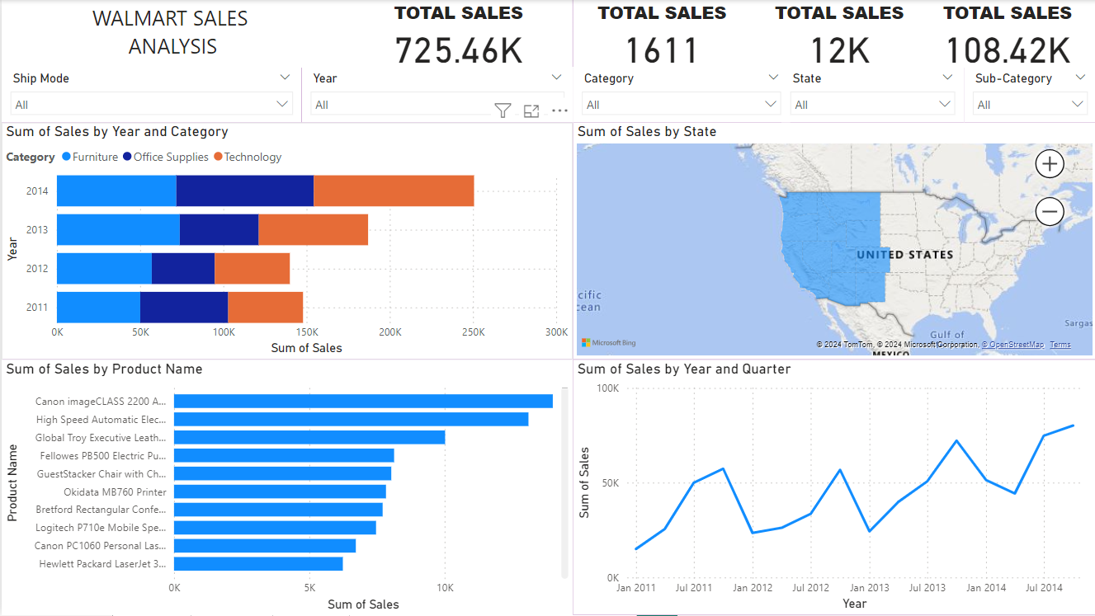
SALES DASHBOARD

Slide 5
HIGHLIGHTS OF SALES ANALYSIS
SUM OF SALES BY YEAR AND CATEGORY
SUM OF SALES BY PRODUCT NAME
SUM OF SALES BY STATE
SUM OF SALES BY YEAR AND QUARTER

